Slide 1
FORECASTING AGRO-FOOD CO₂ EMISSIONS UNDER POLICY SCENARIOS
Abby Peck, Abhiroop Kumar, Grace Lin,
Shruthi Chembu, Vyshnavi Maringanti

Slide 2
TABLE OF CONTENTS
01
02
03
04
THE PROBLEM
THE SETUP
Let's start with a small data dump
Before building a pyramid...
THE WORK
THE FINALE
Different pyramids, different structures!
Let's talk about the future.

Slide 3
01
THE PROBLEM

Slide 4
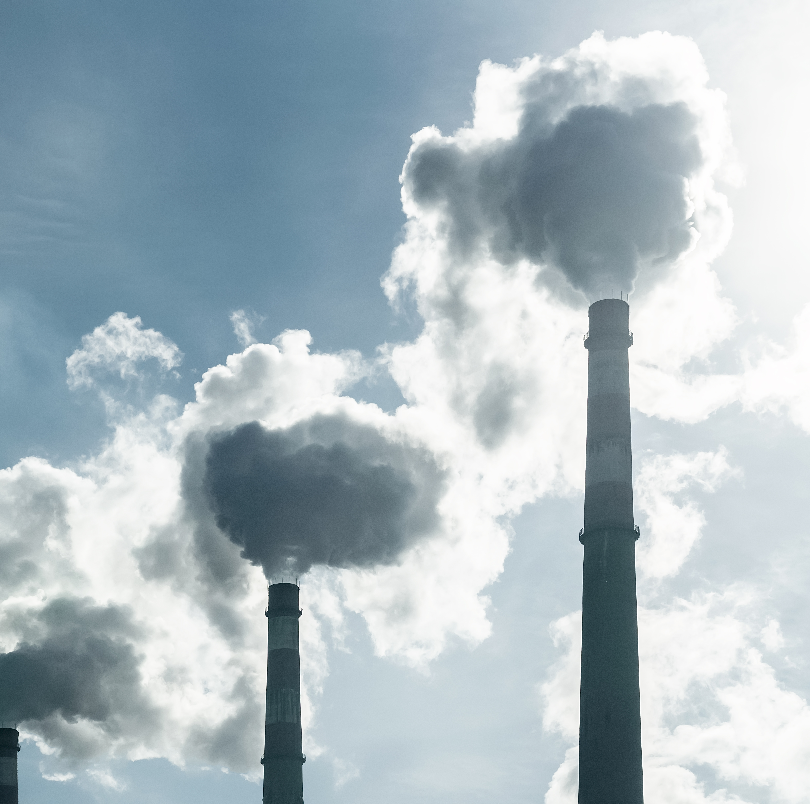
AGRICULTURE'S CLIMATE CHALLENGE
Agriculture emits CO₂, CH₄, N₂O through fires, fertilizers, manure, and land-use change
Compared to energy or transport, agriculture is harder to modernize due to ecological and biological constraints
This motivates the need for predictive, scenario-based modeling to explore future emission trajectories
What we are attempting:
Agricultural practices → Emissions →
Long-term temperature impact

Slide 5


GLOBAL TEMPERATURE BENCHMARKS
BY YEAR 2100
< 2°C warming above pre-industrial levels
Aim for 1.5°C
THE PARIS AGREEMENT
(2015)
AGRICULTURE IS BOTH:
A major emitter, and
A potential carbon sink

Slide 6

AGRI-FOOD CO₂ EMISSION DATASET
~7,000 rows × ~31 columns of country-year agricultural emission records.
INCLUDES:
Burning emissions: Savanna fires, Forest fires
Crop processes: Rice cultivation, Crop residues
Land-use: Net forest conversion, Forestland
Industrial agriculture: Fertilizer manufacturing, Pesticide production
VECTORS:
Covers both emission flows and production activity indicators.
Source: Kaggle dataset by Alessandro Lobello
TARGET: total_emission

Slide 7

"What-If" AGRICULTURAL FUTURES
BASELINE
BAU
Business-as-usual, assuming current trajectories continue
SCENARIO A
Mild reductions to key emission-related features
Represents achievable, policy-friendly agricultural reform
MODERATE
SCENARIO B
Objective: Understand how agricultural changes ripple through
Large reductions across the same features
Represents high-ambition Paris-aligned transformation
AMBITIOUS
Emissions → Scenario-based reductions → Climate modeling

Slide 8
THE SETUP
02

Slide 9





CLEANING, QUALITY AND PREPARATION
Data Integrity Checks:
Standardized dtypes,
Area → categorical
Year → integer
Several emission variables have close to 20–29% missingness:
3-stage imputation pipeline (country & time-aware)
1. Within each country:
Interpolate across years
2. Country-level fill:
Remaining gaps → country means
3. Fallback:
Global median fill

Slide 10
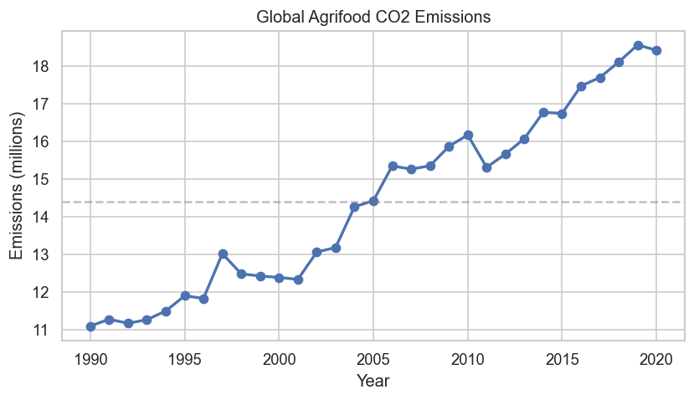
WHAT DOES THE DATA ACTUALLY LOOK LIKE?
Key Insights
236 areas with annual records from 1990–2020
Global agrifood CO₂ emissions increased ~66% since 1990
Clear upward trend, with minor downward patterns in-between

Slide 11
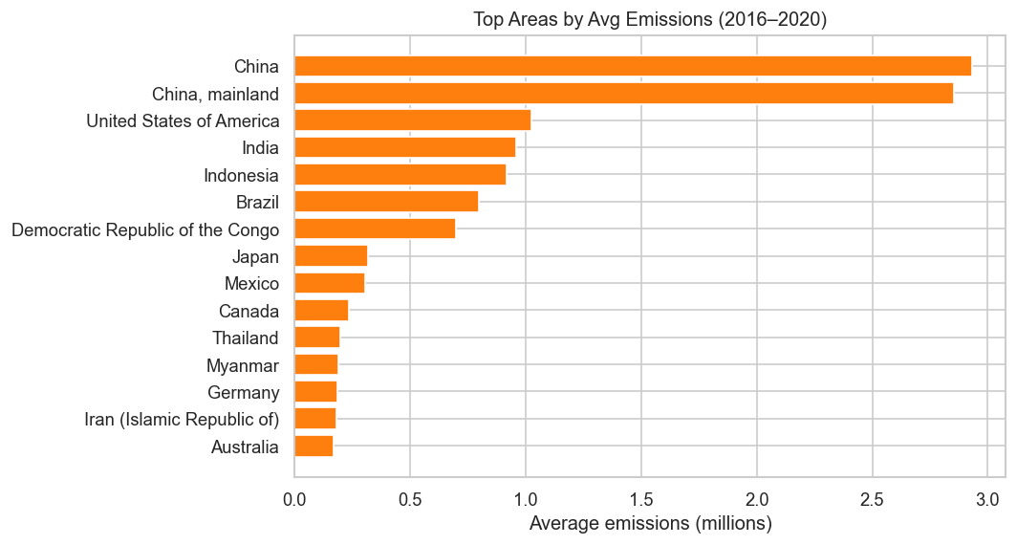
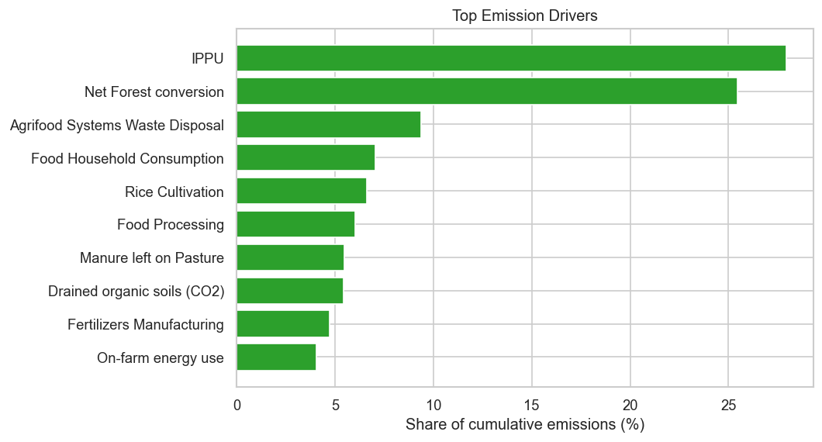
WHERE DO EMISSIONS COME FROM?
GEOGRAPHIC PATTERNS
Top 5 emitting countries together account for only ~9.6% of global emissions
Rest of the emissions are widely spread across countries, not dominated by a few
COMPOSITION PATTERNS
Industrial & land-use sources dominate:
IPPU + Net Forest conversion
contribute >50% of total emissions

Slide 12
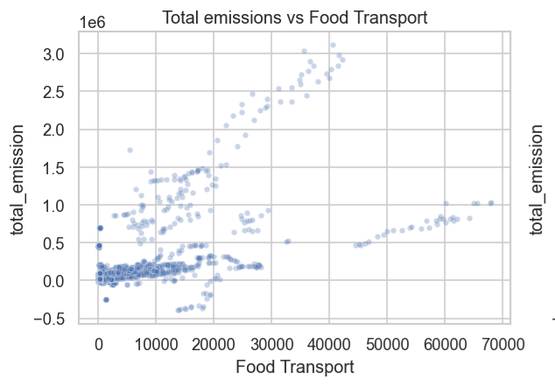
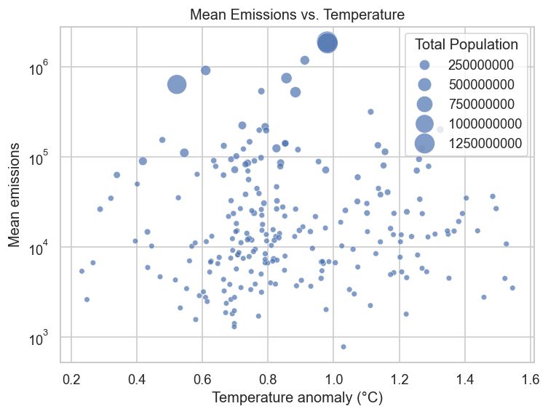
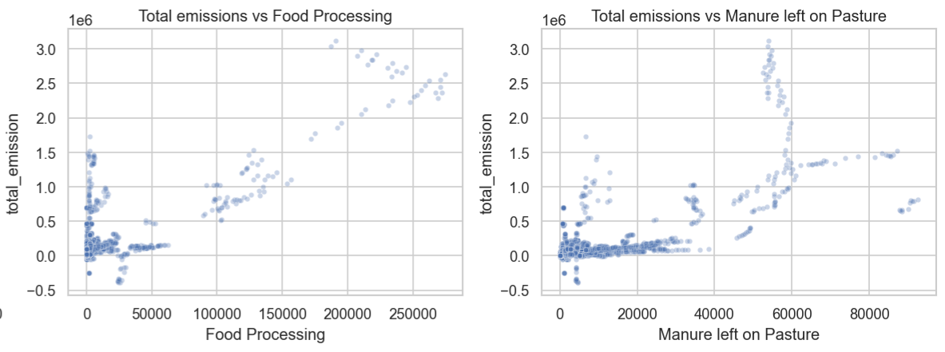
WHAT CORRELATES WITH EMISSIONS?
Correlations:
Emissions vs Population: strong (r ≈ 0.86)
Emissions vs Temperature: almost zero (r ≈ –0.01)
Food Transport → strong positive association
Food Processing → strong positive association
Manure left on Pasture → moderate positive association
Driver Correlations:

Slide 13
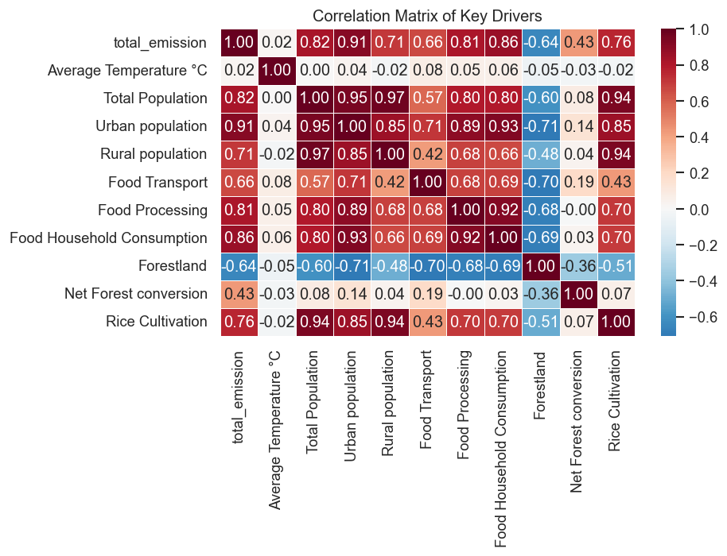
ARE THE DRIVERS CORRELATED?
Transport, processing, and household consumption show strong positive ties to total emissions,
while Forestland is inversely related to Net Forest conversion, capturing the reforestation vs. deforestation tug-of-war that can inform scenario modeling.

Slide 14
DISTRIBUTIONS, SKEW & OUTLIERS
DISTRIBUTION FINDINGS | Heavy right-skew in major drivers (total_emission, IPPU, Net Forest conversion, etc.) Log transformations to stabilize variance
OUTLIER ANALYSIS | Extreme values in land-use variables, but are legitimate (real events) No implausible population or temperature values

Slide 15
03
THE WORK

Slide 16
THE PIPE OF RESEARCH
ML Modeling: Select the best prediction model by trying several methods
Scenario Linear Scaling: Scale Agrofood Variables into three scenarios
Time Series: Forecast future CO₂ by the three scenarios (trained and tested by past data)
END GOAL
Forecast future CO₂ emissions using Agrofood Variables
ML Prediction Models
Scenario Scaling
Time Series Forecasting

Slide 17
THE MODELS
ESTABLISHING THE BASELINE (Ridge, Lasso, RF and XGBoost)
Handling Multicollinearity: Ridge/Lasso penalize correlated features
Capturing Non-Linearity: Tree ensembles (XGBoost) identify saturation points in agricultural inputs
Feature Importance: Identification of high-impact drivers (Forestland, Forest fires)
CAPTURING TEMPORAL DYNAMICS (LSTM & TFT)
Sequential Dependencies: LSTMs capture long-term lags
Temporal Fusion Transformer (TFT):
Explicitly separates static metadata from time varying inputs
Automatically selects relevant features while suppressing noise via gating
Uses attention mechanisms to identify significant historical time steps
Interpretable weights reveal which past events drive current predictions

Slide 18
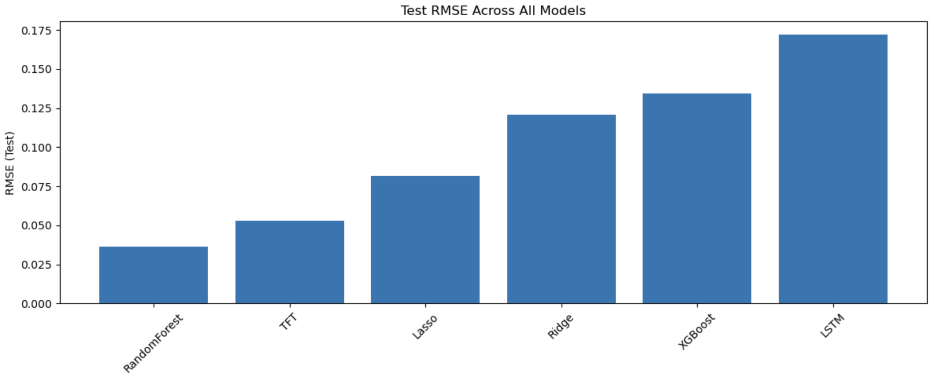
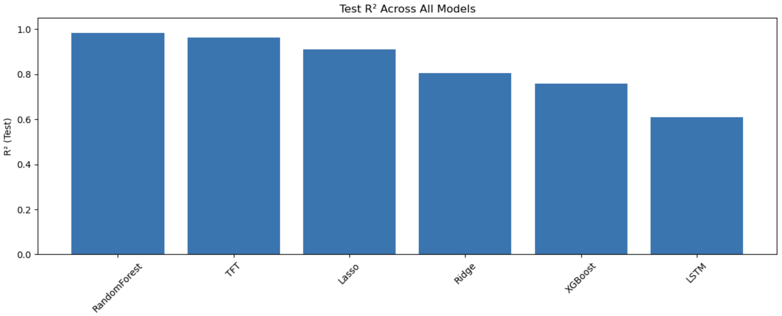
HOW DID THE MODELS PERFORM?
Random Forest performed the best of all the models, with TFT as a close second
All the models were all tuned to find the best hyper parameters
The models were trained on data from 1990-2014 and tested on data from 2014-2020

Slide 19
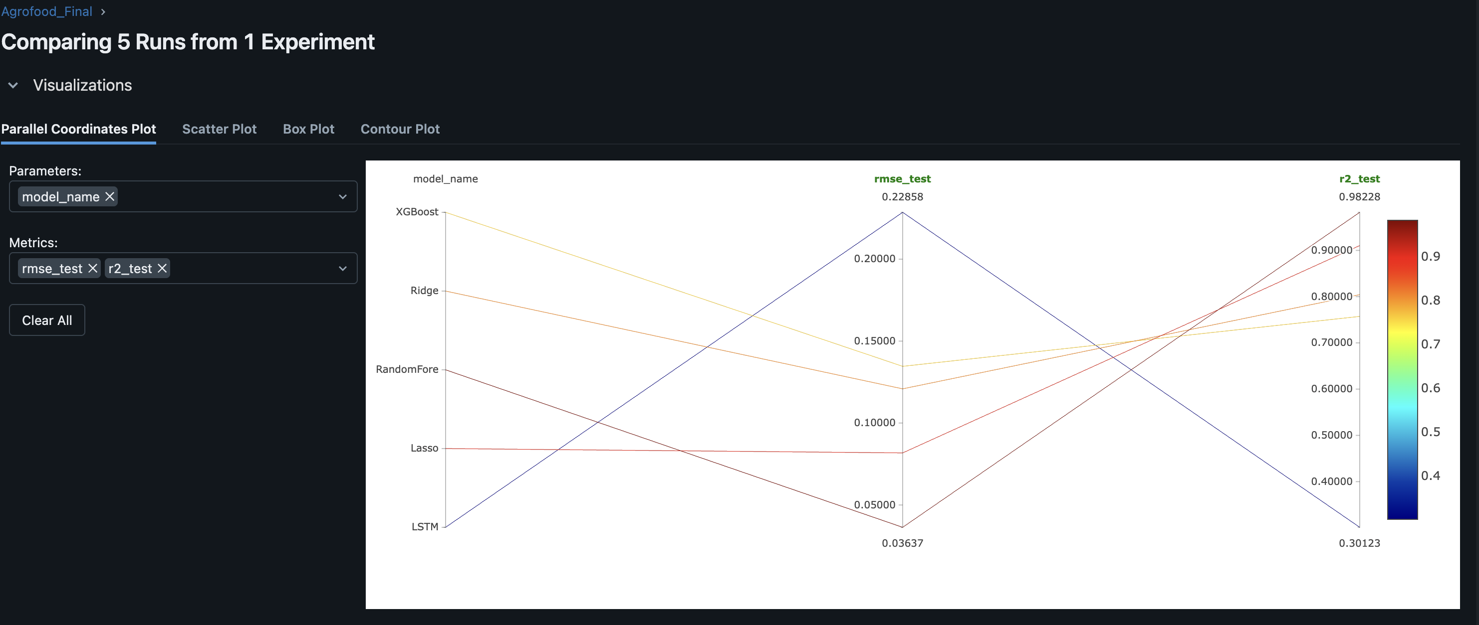
MLFLOW SS

Slide 20
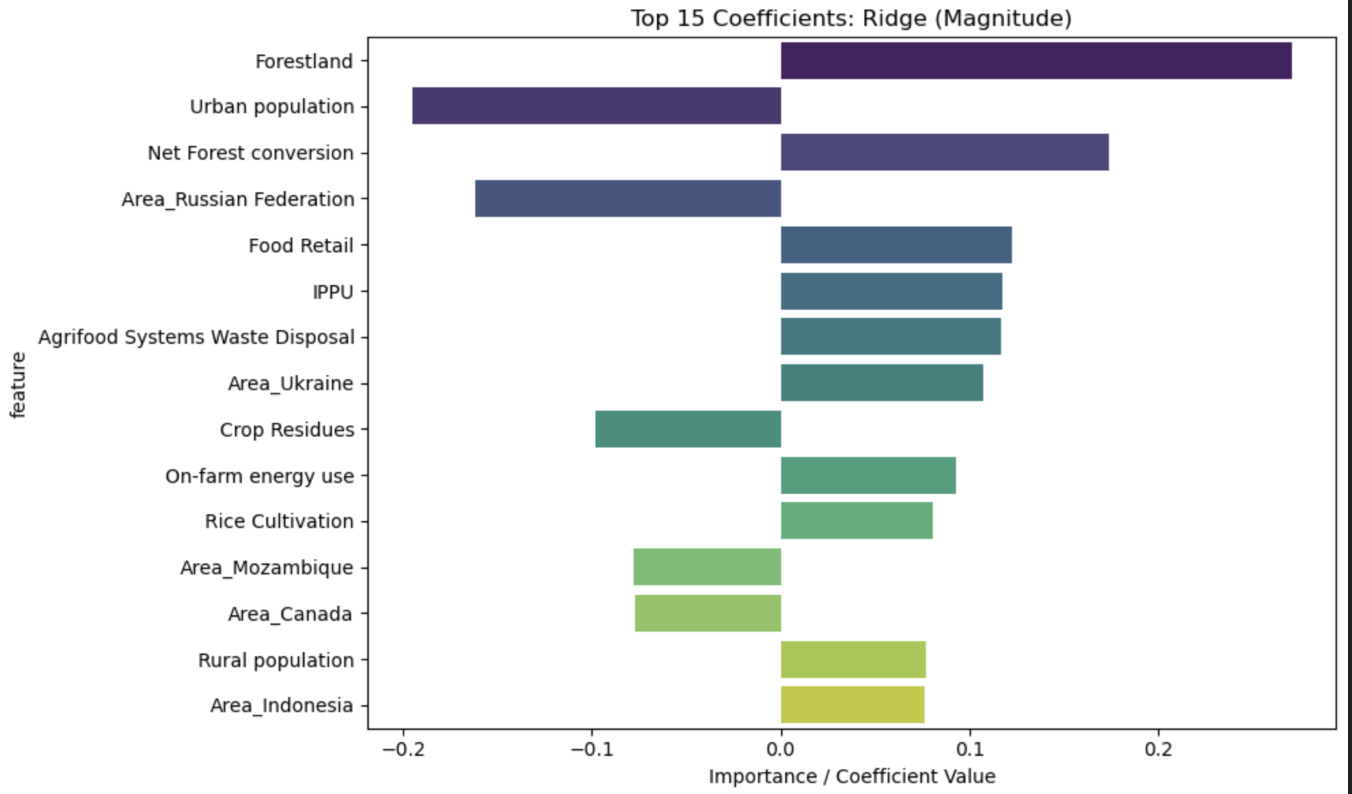
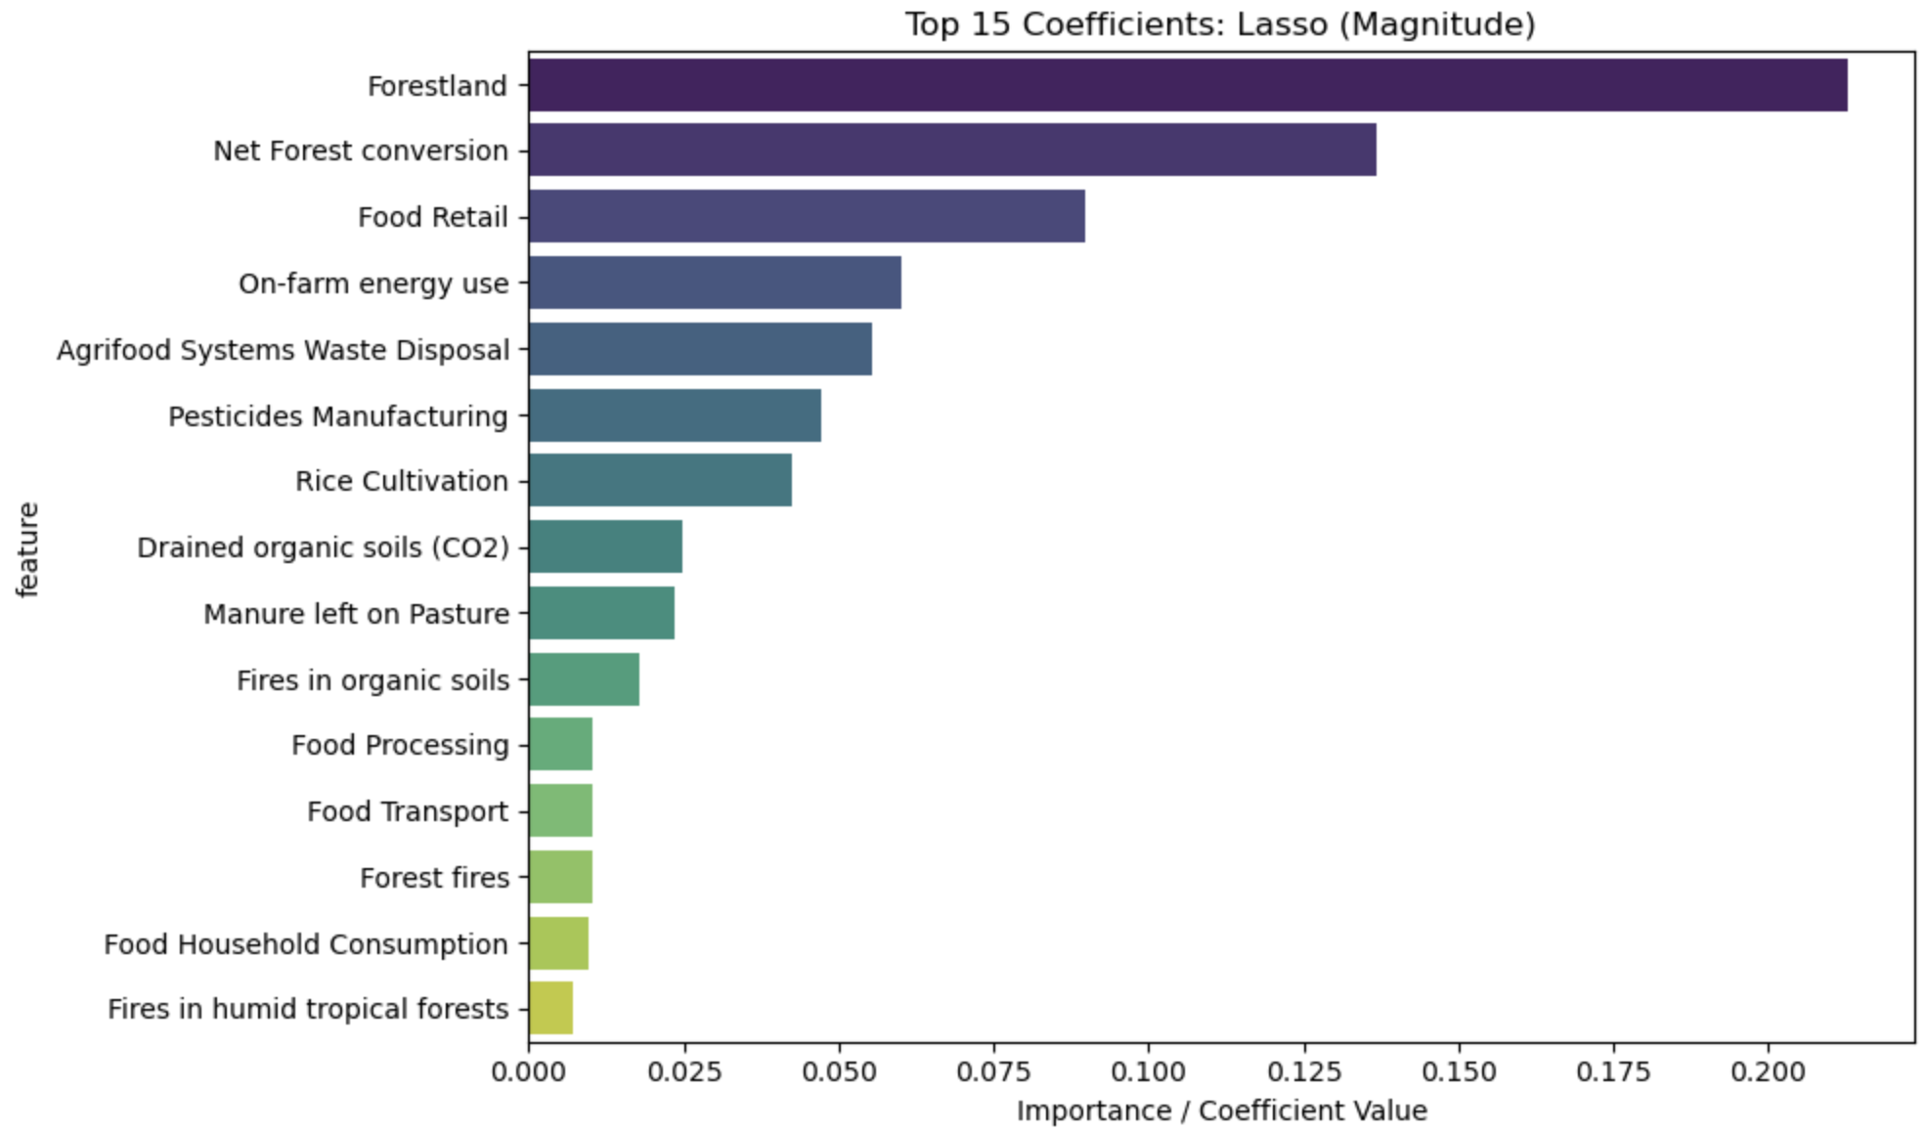
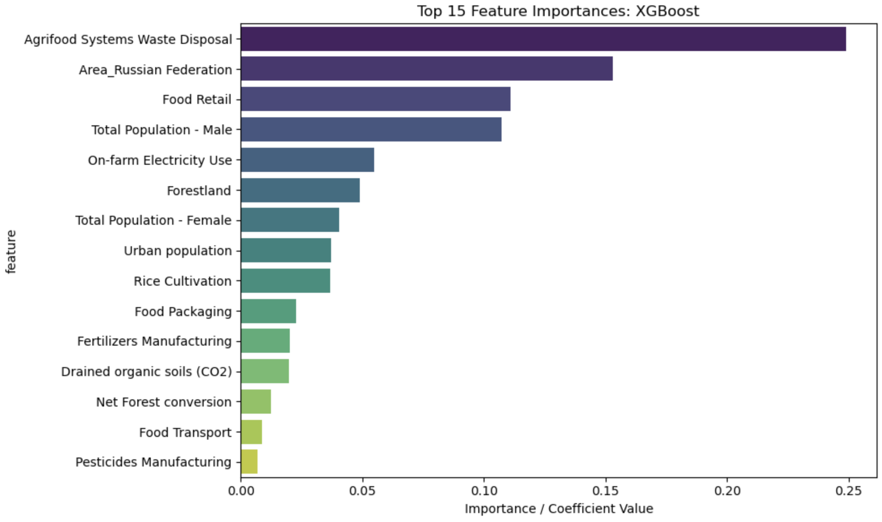
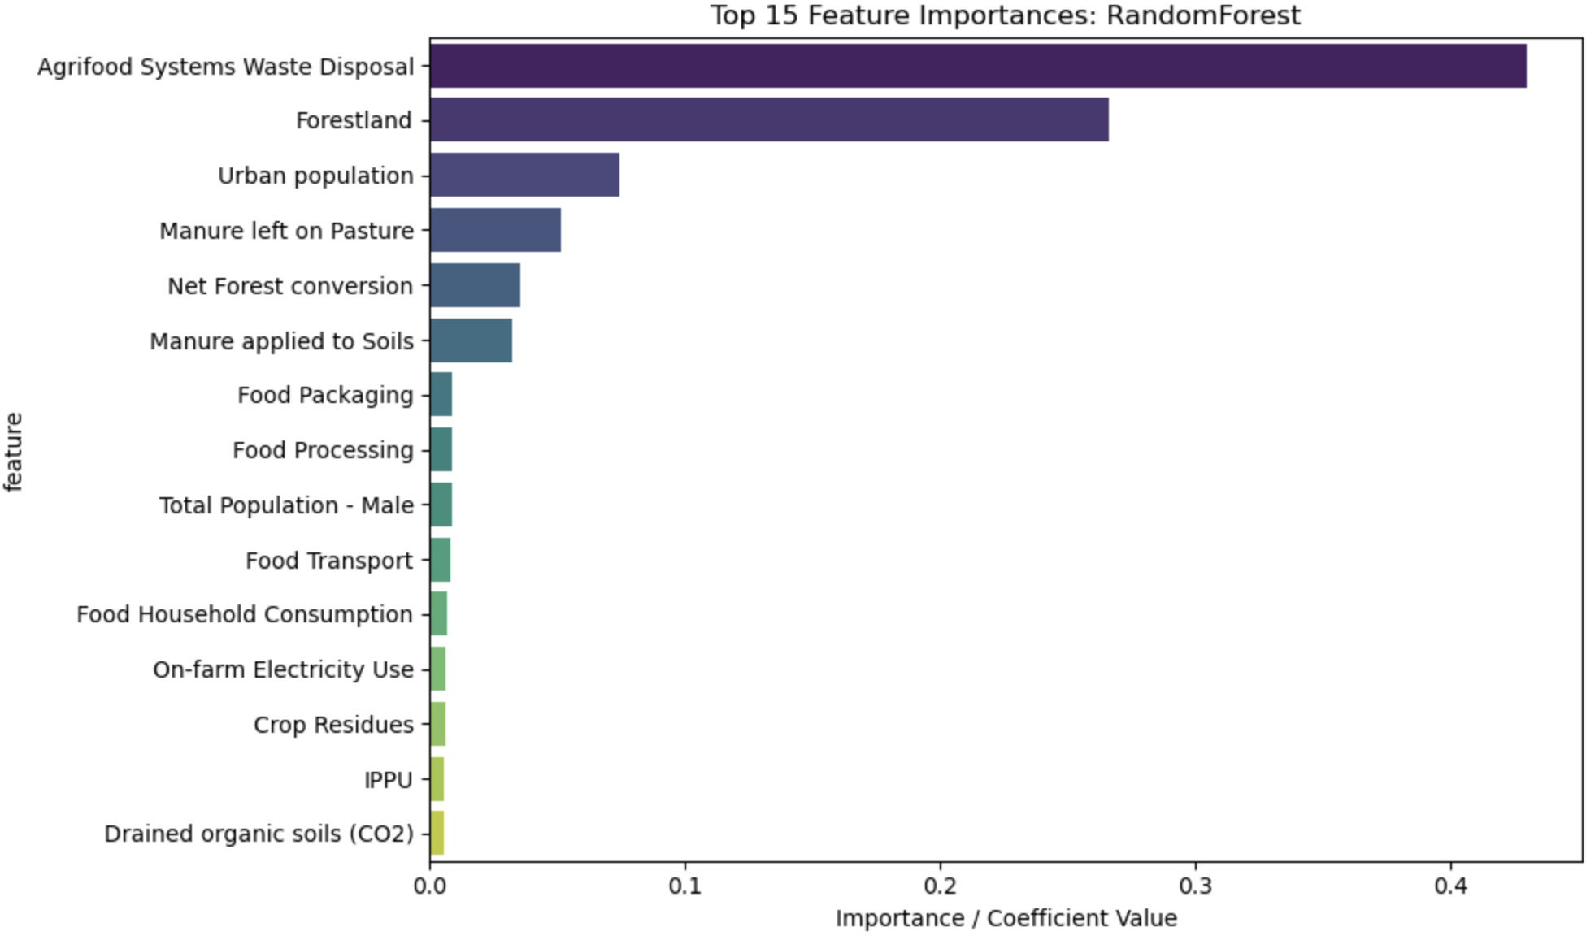
LOOKING AT IMPORTANT FEATURES

Slide 21
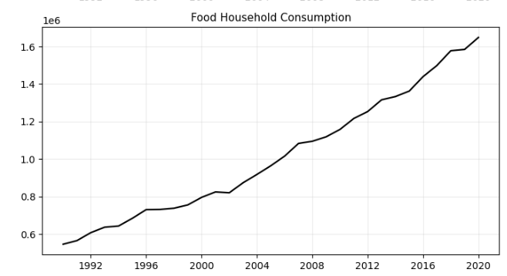
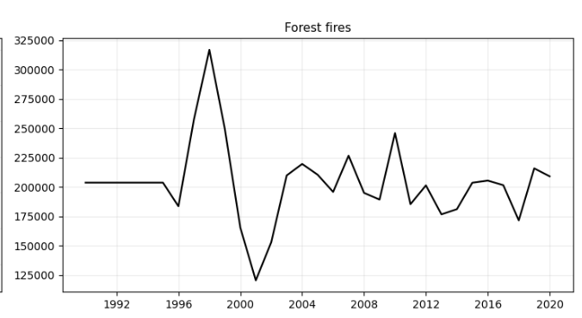
FORECASTING DATA ~2100
SMOOTH VARIABLES
Recognizable trend (mostly upward)
Damped Exponential Smoothing
Variables like: On-Farm Electricity, Food Retail, Food Household Consumption, Population
NOISY VARIABLES
No significant trends (mostly related to natural disasters)
ARIMA(1, 1, 1)
Variables like: Forest Fires, Savanna Fires, Fires in Organic Soils
?

Slide 22
CREATING SCENARIOS
TWO POLICY SCENARIOS GROUNDED IN RANGES USED BY:
IPCC AR6 Mitigation Pathways
FAO Agrifood Systems Mitigation Analyses (2021–2023)
Integrated Assessment Models (IAMs) such as SSP1 / SSP2
Literature on methane & N₂O mitigation in agriculture
THESE FRAMEWORKS COMMONLY ASSUME MULTIPLIERS:
10–25% reductions for moderate mitigation (Scenario A)
30–70% reductions for high-ambition pathways (Scenario B)

Slide 23
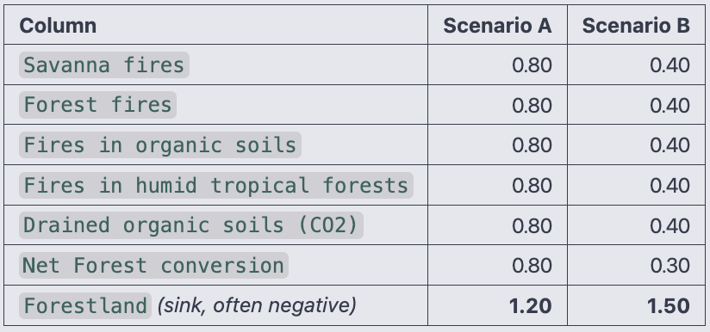
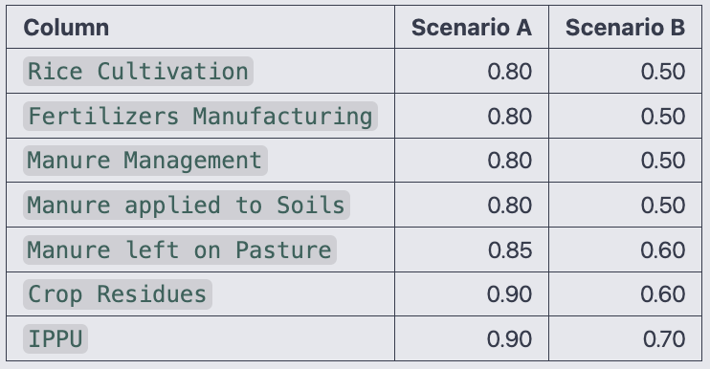
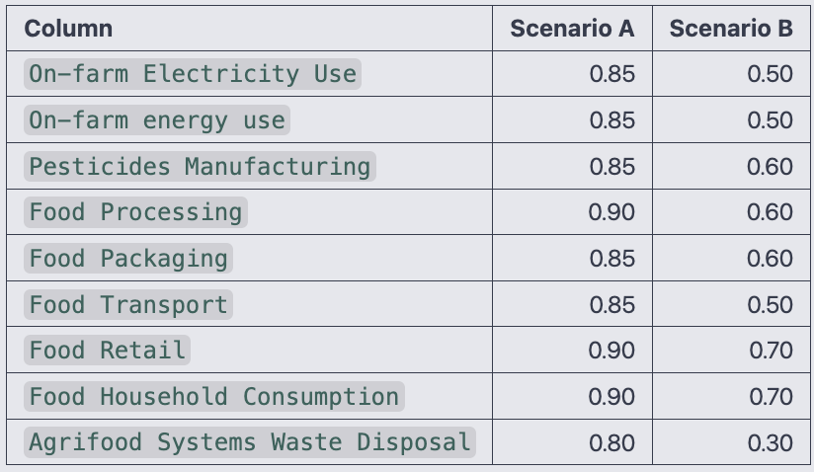
SCENARIO-WISE FEATURE REDUCTION
Land-use
and Fire
Fertilizer, Manure, Rice, and Residues
Energy, Supply Chain, and Consumption

Slide 24
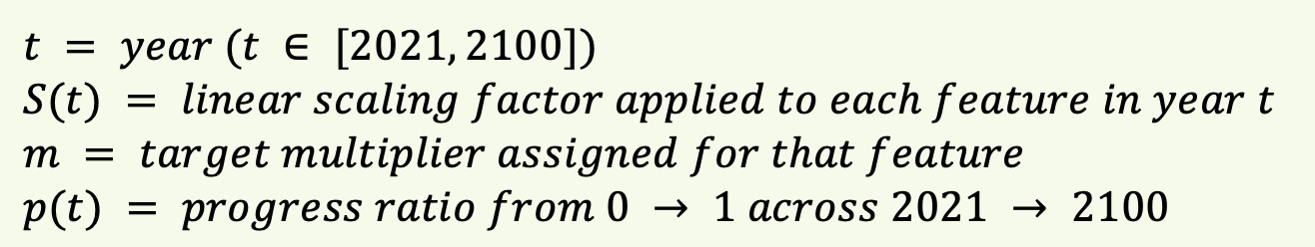
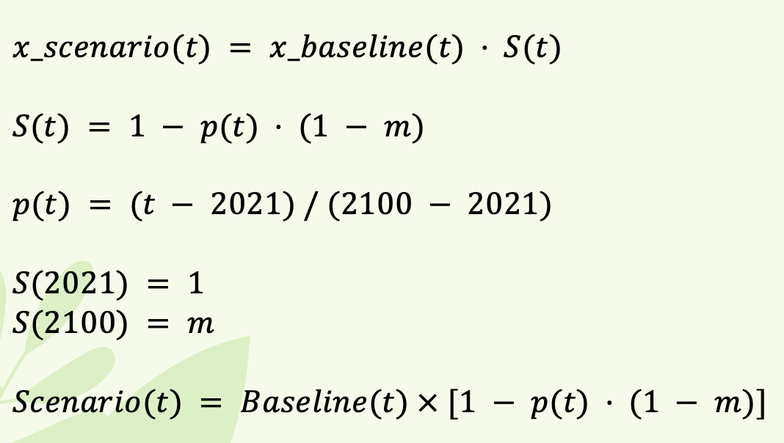
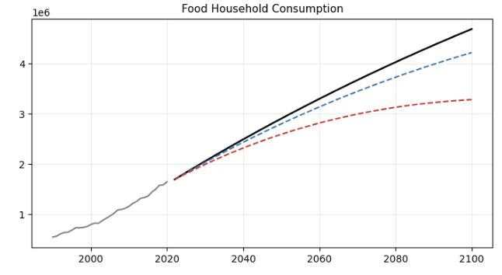
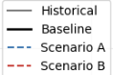
BREAKING DOWN SCENARIO CREATION

Slide 25
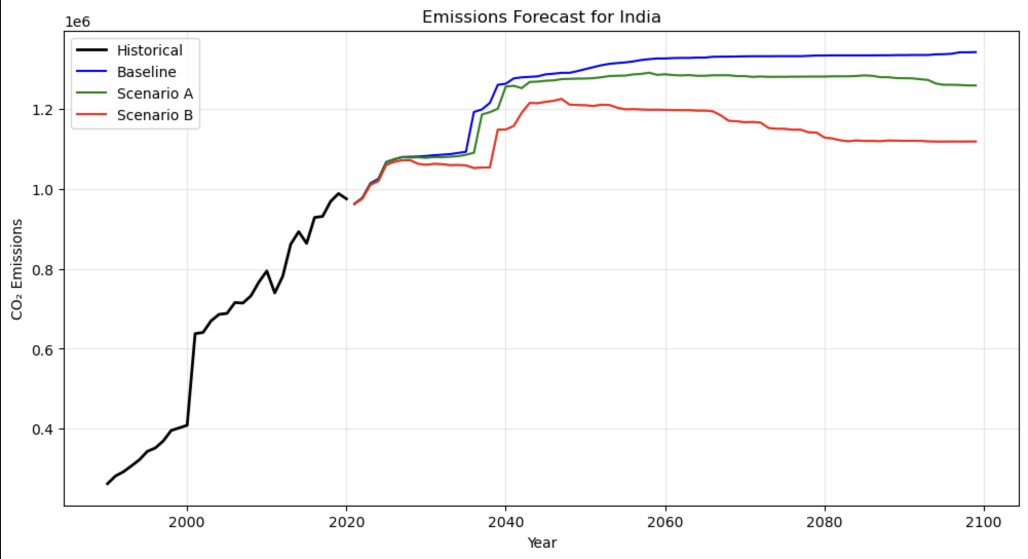
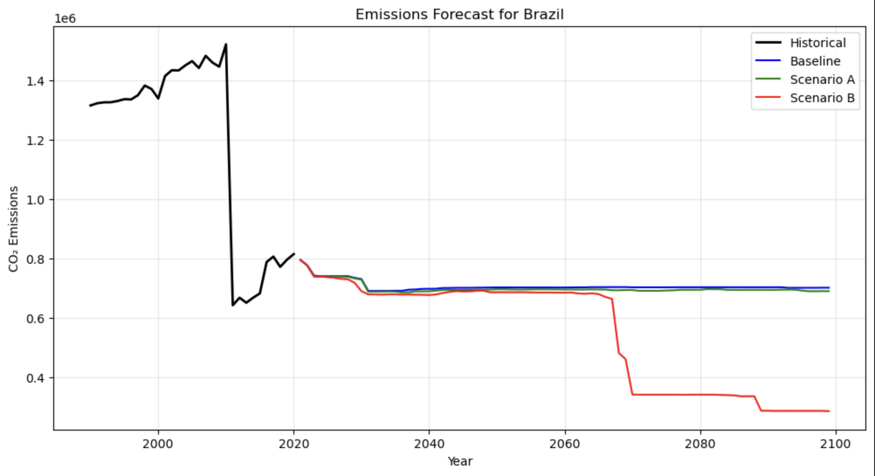
FORECASTING THE RANDOM FOREST
Baseline projects continued emissions growth following historical momentum
Moderate reduction scenario slows the rate of increase but fails to reverse the trend
Heavy reduction scenario successfully breaks the upward trajectory and stabilizes emissions after 2040 for India and triggers a massive structural drop around 2065 for Brazil

Slide 26
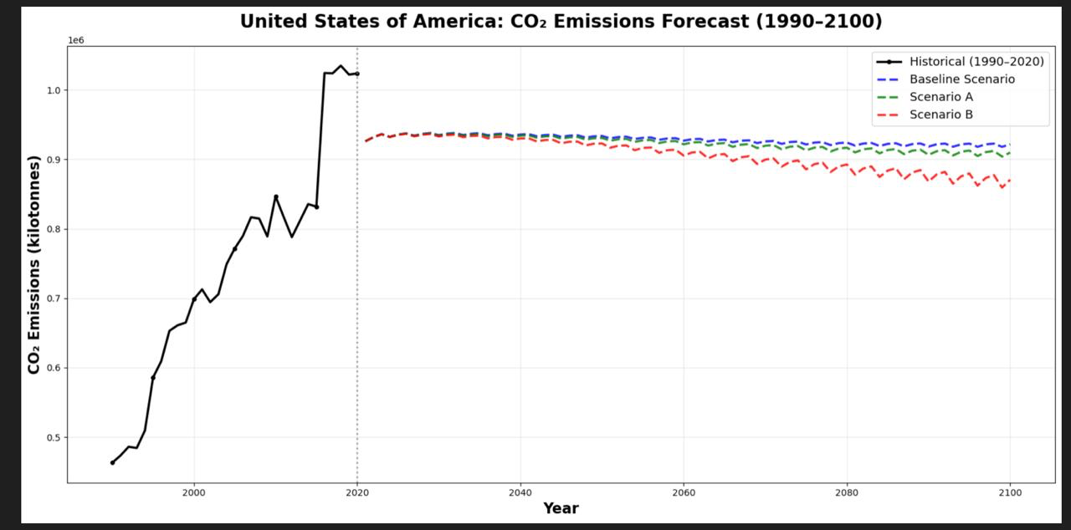
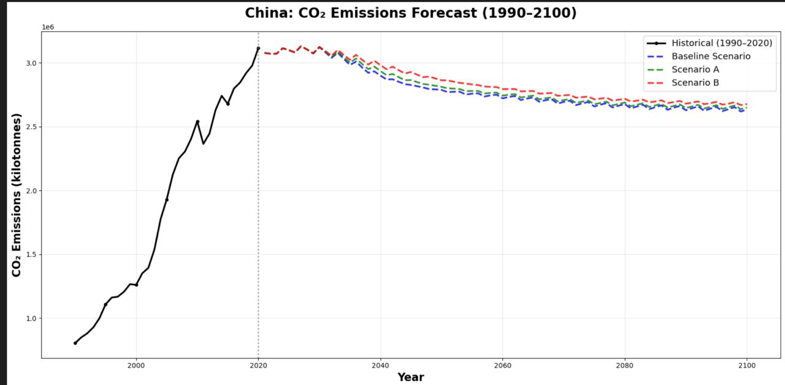
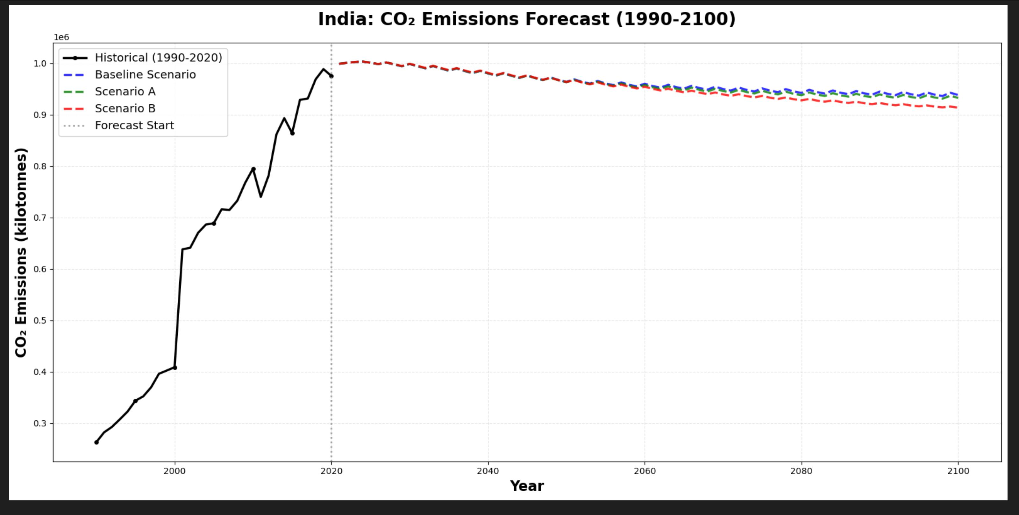
THE TFT REPORT
Long-range emission forecasts for major emitters using the trained TFT model
All three countries show stabilizing or slightly declining baseline emissions once the historical trend peaks
Scenario A produces moderate reductions, while Scenario B consistently achieves the largest and earliest declines across all countries
The spread between Baseline, A, and B illustrates how policy intensity directly shapes long-term emission pathways

Slide 27
CONCLUDING OUR ANALYSIS
SUMMARY:
Models achieved high accuracy (R²: RF - 0.96, TFT - 0.98)
We successfully extrapolated emissions through 2100 with stable long-term behavior
Scenario A (10-25%) and Scenario B (30-70%) tuned key agricultural emission drivers, reducing the key emission drivers
Both scenarios show lower long-term emissions for most countries
This demonstrates that our policy-based parameter adjustments can effectively model and guide potential emission-reduction strategies.

Slide 28
THE FINALE
04
Just __ more slides to go!

Slide 29
OPTIONAL IMPROVEMENTS
RICHER FEATURES
BROADER MODELS
BETTER SCALING
Add interactions and temporal trends
Include SGD and other Boost variations
Apply Box-Cox or robust transformations
SCENARIO TESTING
TIME HORIZONS
FaIR INTEGRATION
Vary policy multiplier intensities
Explore alternative
forecast window lengths
Introduce climate-model temperature conversion

Slide 30
FUTURE CONSIDERATIONS
SCOPE EXPANSION
Incorporate other major climate drivers (energy, automobiles, factories) for holistic forecasts
RICHER SCENARIOS
Move from fixed multipliers to policy-driven interventions (carbon pricing, fertilizer caps, reforestation)
ADVANCED MODELING
Explore nonlinear ML, uncertainty modeling, and richer FaIR inputs
(CH₄, N₂O, aerosols)
BETTER DATA
Add sub-national detail, crop-level breakdowns, and forward-looking projections
FEEDBACK LOOPS
Integrate climate-agriculture interactions
(temperature → yields → emissions)

Slide 31

THANK YOU QUESTIONS?

